Slide 1
Maize exercises
Annotation

Slide 2
Exercise 1: Problems annotating single exon genes
The genes: Zm00001d039116 and Zm00001d041417 have been reported to not be included in the ZF-HD-TF gene family (22 members) but there are experimental data that supports they belong to the same family.
All member of the family are “single exon genes”
Zm00001d039116 has two exons in B73v4 and one in B73v3
Zm00001d041417 has four exons in B73v4 and no annotation data in B73v3
We will look in detail

Slide 3
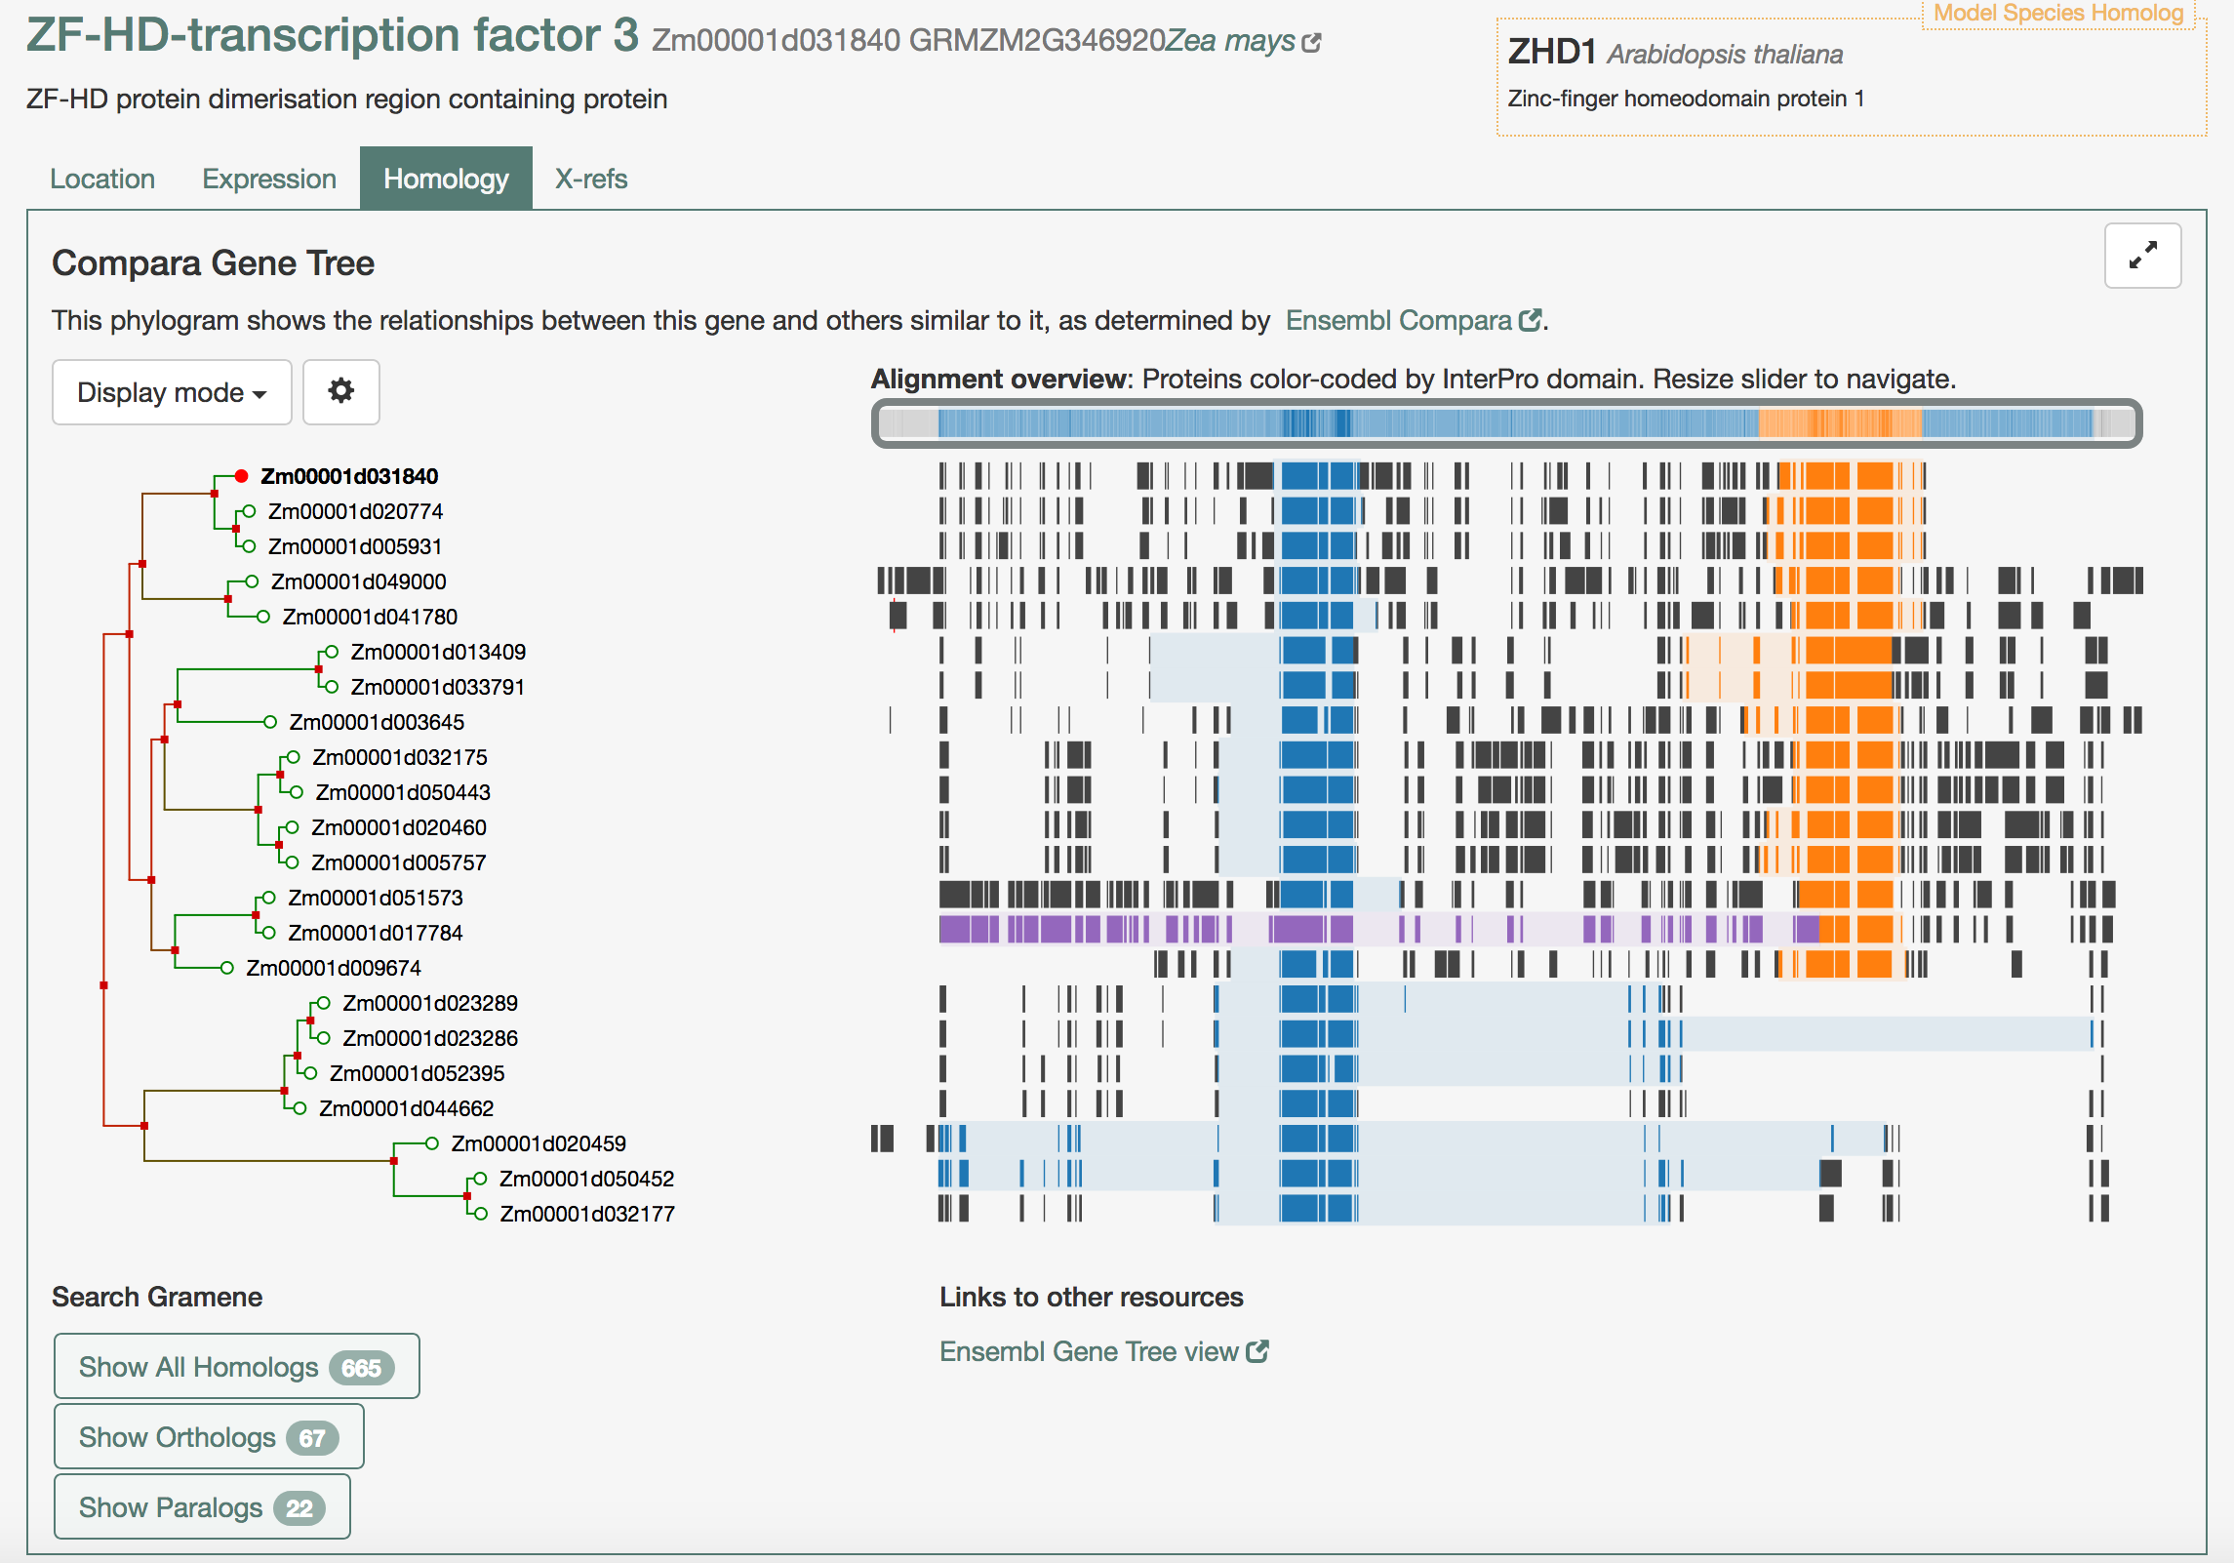
ZF-HD-transcription factor family
The gene tree shows the 22 members of the family and highlighted the two main domains: ZF-HD homeobox protein, Cys/His-rich dimerization domain (blue) and the homeobox domain-like (orange).

Slide 4
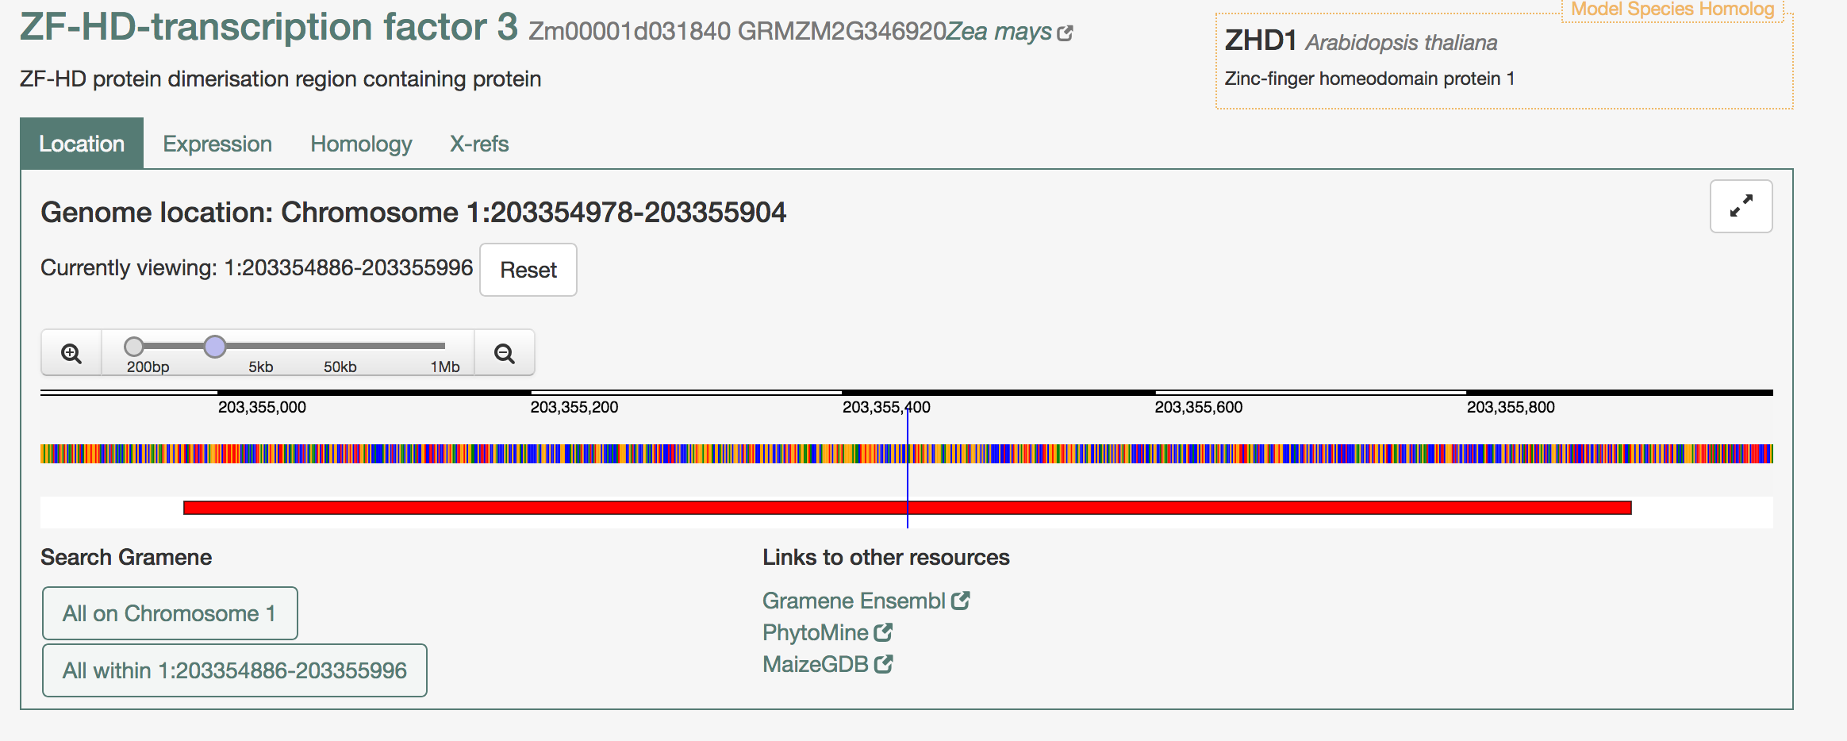
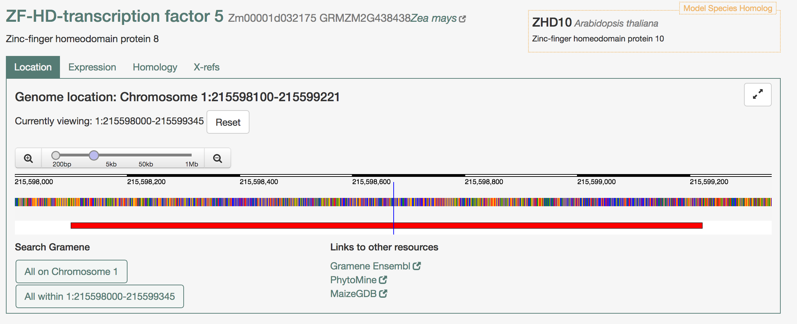
Single exon ZF-HD-transcription factor family
Once you select the genes you can see the location and the structure with only one CDS. Two examples in here.

Slide 5
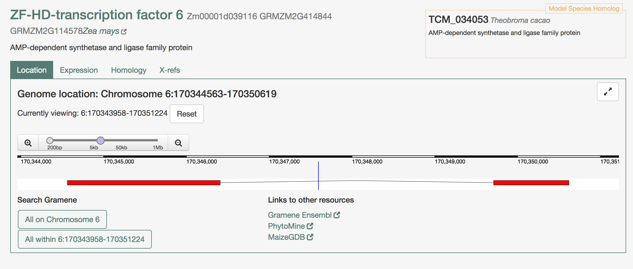
Zm00001d039116
The first gene we are looking into shows two exons and it has been classified as AMP-dependent synthetase and ligase family protein and called ZF-HD-transcription factor 6.

Slide 6
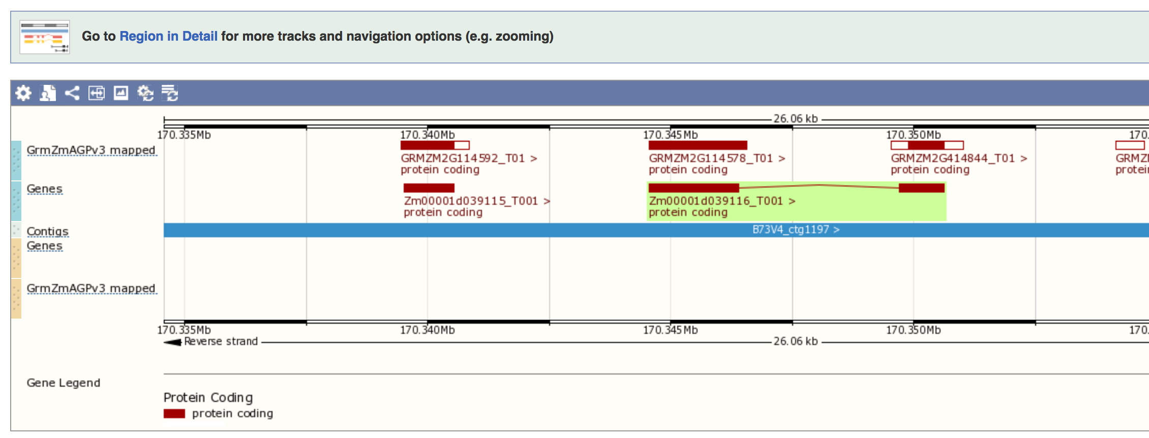
Zm00001d039116
Before going into Apollo we check in Gramene Ensembl to compare with the previous assembly B73v3.
Our first thought is that the v3 assembly is correct and annotate a single exon gene: GRMZM2G414844 and the v4 assembly is wrong and fuse two genes together (GRMZM2G114578 and GRMZM2G414844)

Slide 7
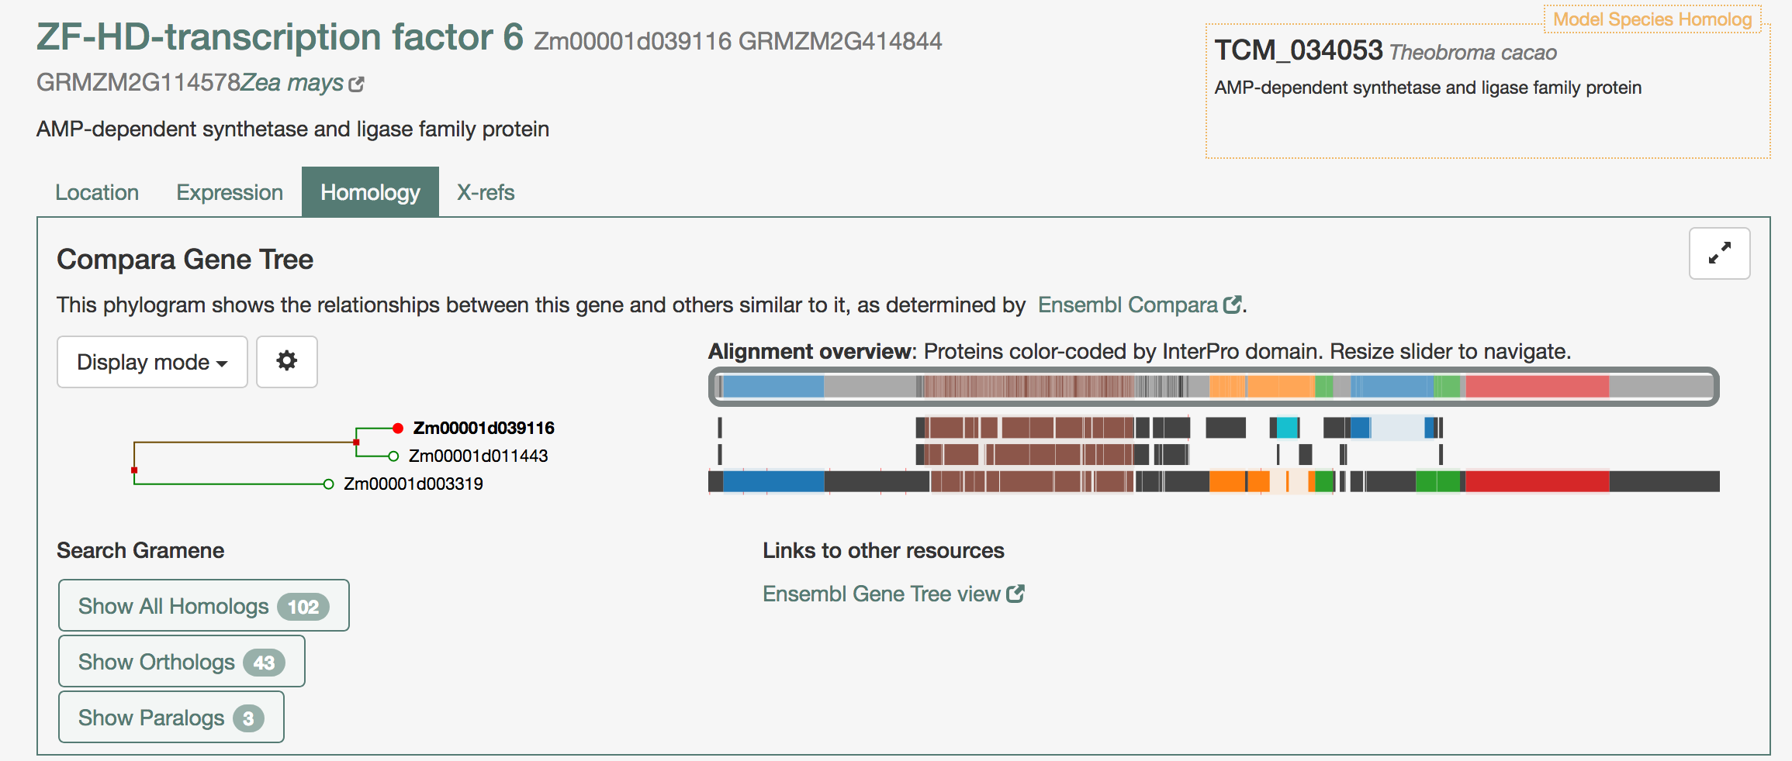
Zm00001d039116
We went back to Gramene to identify the paralogs and it shows they share a common domain for AMP-dependent synthetase/ligase. Looking for other domains our gene of interest shows the ZF-HD homeobox protein, Cys/His-rich dimerization domain (turquoise) present in the ZF-HD-TF family.

Slide 8
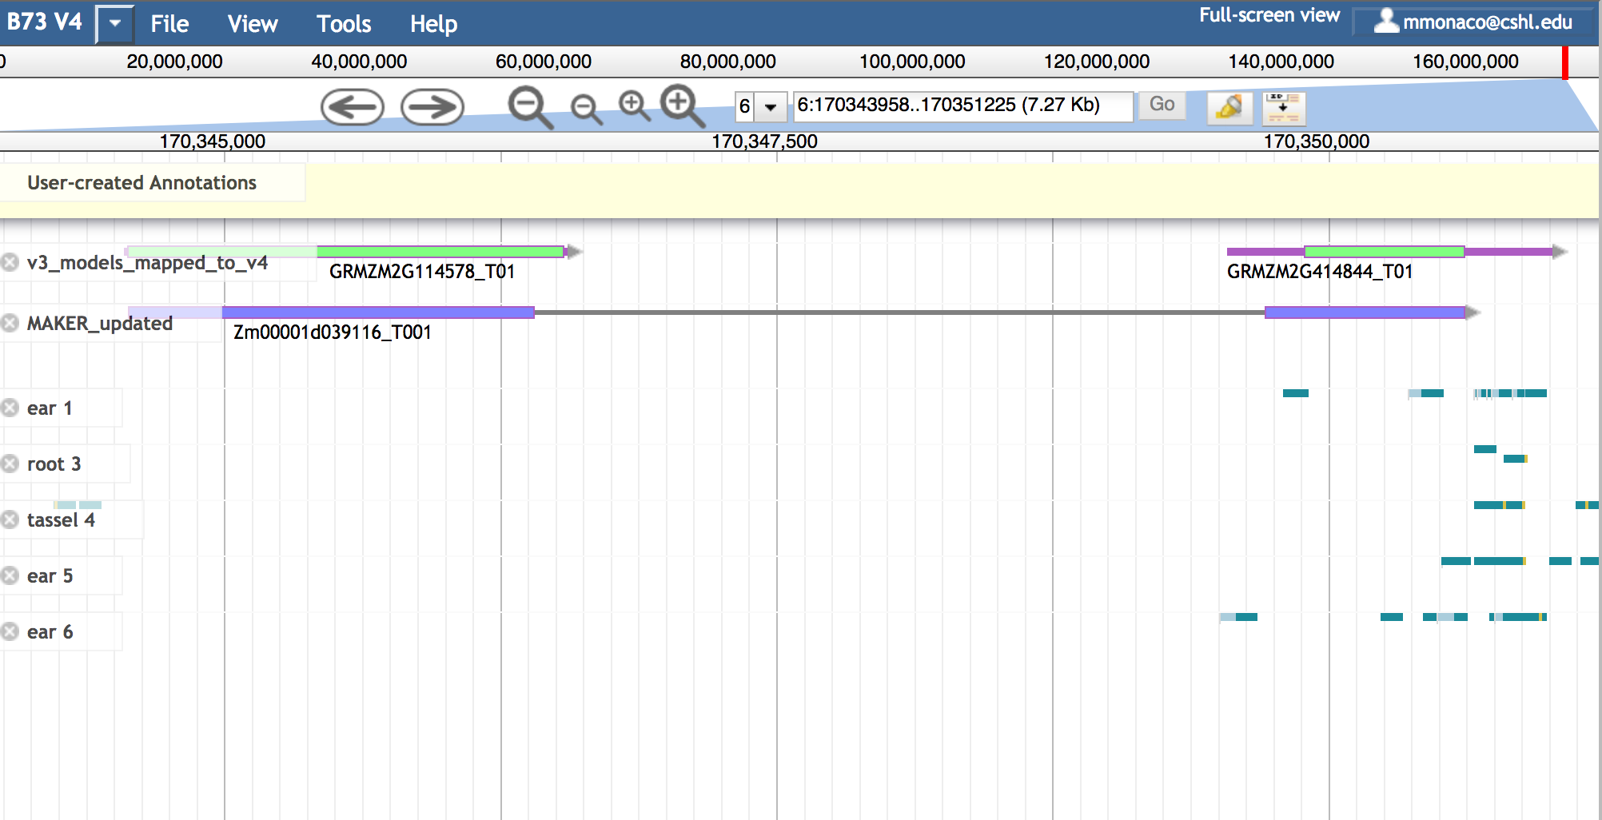
Zm00001d039116 in Apollo
Once we locate the gene in Apollo we can see same results. The v3 annotation is different to the v4. The next step will be to look for evidence in public databases.
We move the gene models to the User-created annotations to retrieve the sequences

Slide 9
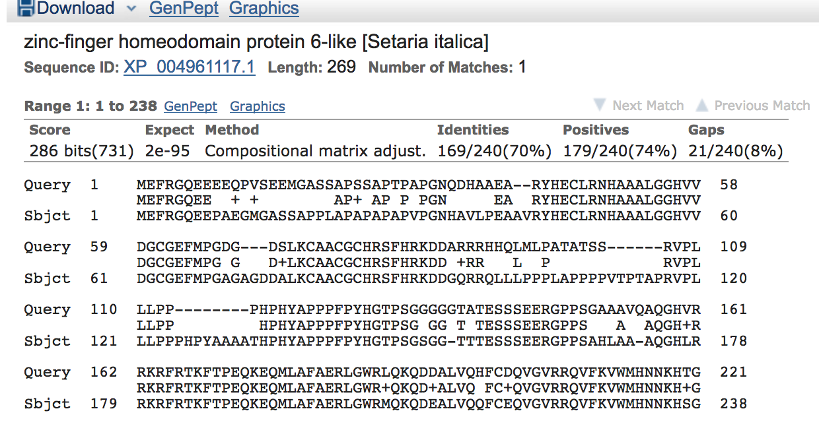
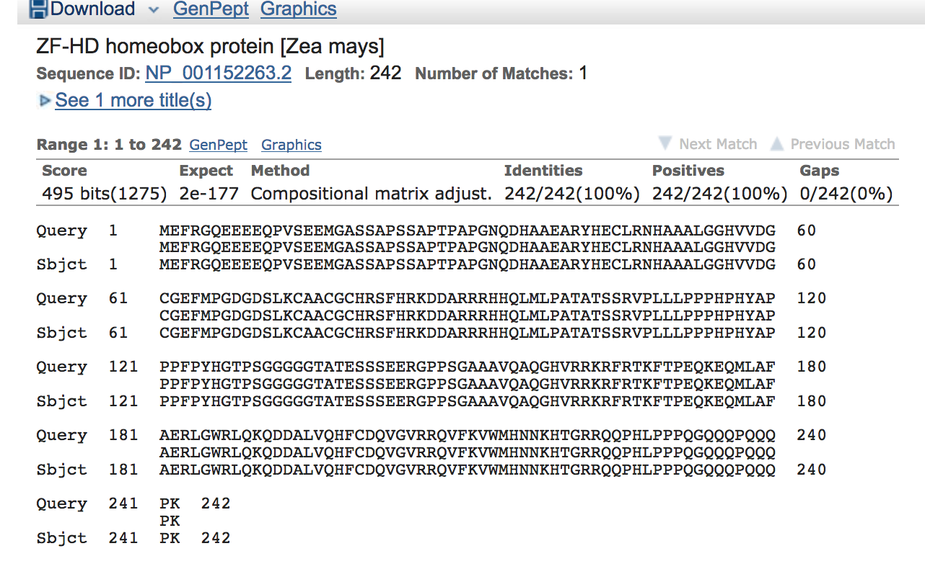
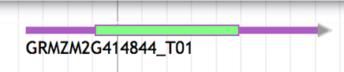
Look for orthologs of this GRMZM2G114578 using BLAST
When we blast the sequence for the gene GRMZM2G414844 and exclude maize the closest ortholog comes from Setaria and when we don’t exclude maize it will match 100% (both zinc-finger homeodomains)

Slide 10
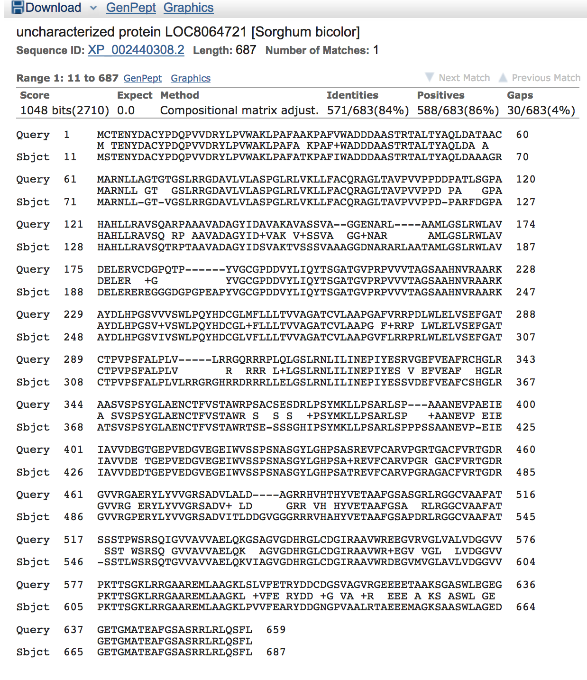
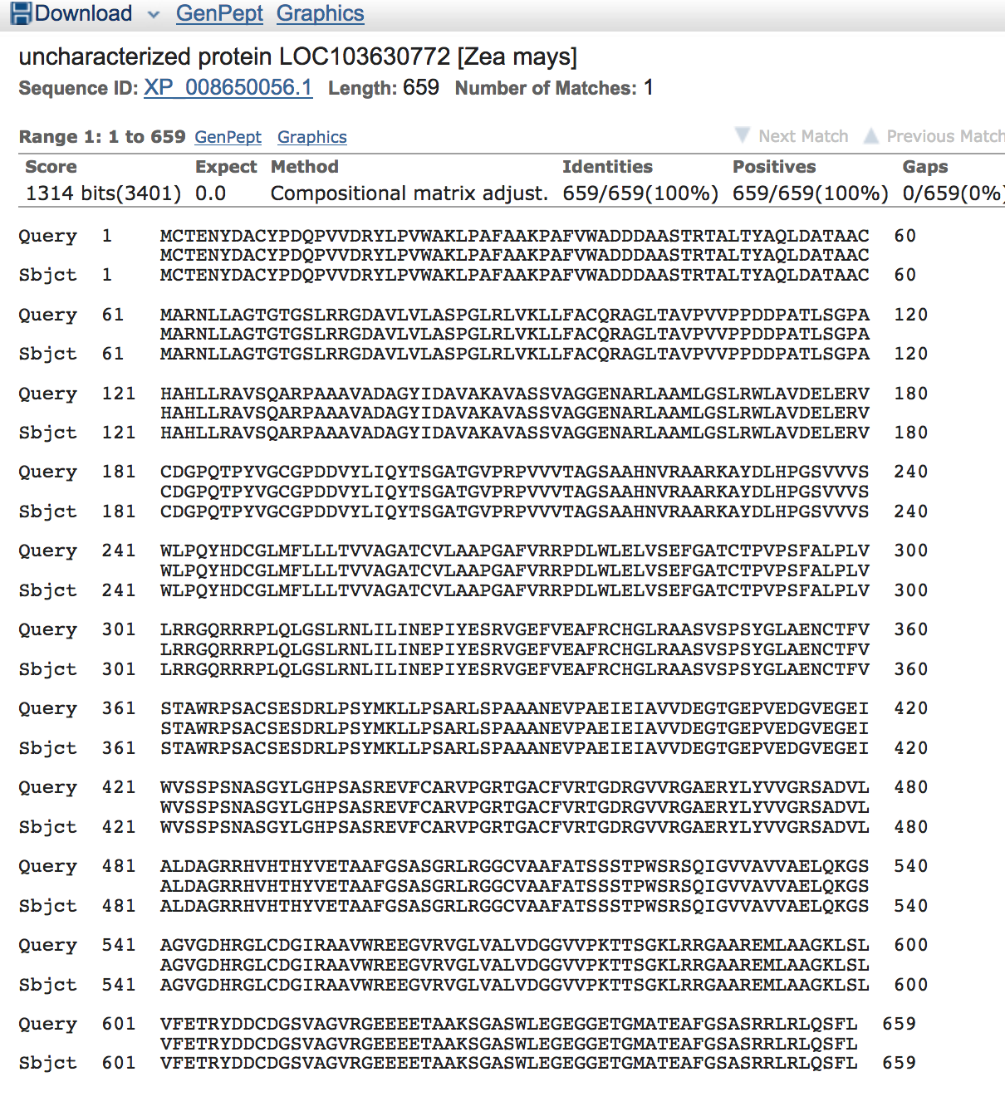
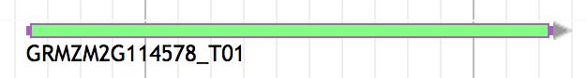
Look for orthologs of GRMZM2G114578 using BLAST
When we blast the sequence for the gene GRMZM2G114578 and exclude maize the closest ortholog comes from Sorghum and when we don’t exclude maize it will match 100% to an uncharacterized protein.

Slide 11
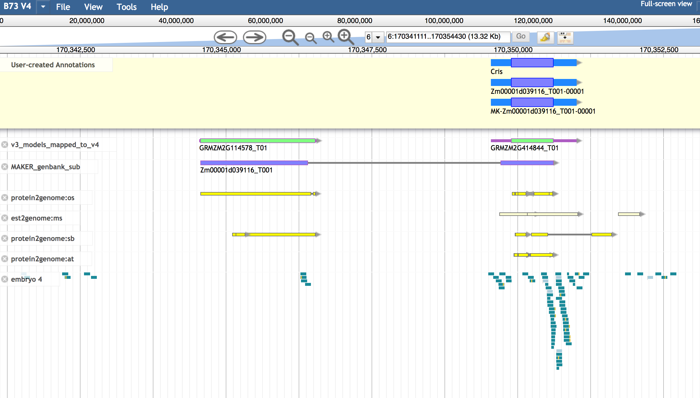
Looking for evidence data in Apollo
We look for evidence that support the v3 assembly and we found some protein sequences and some RNA seq data in the embryo that support the v3 model.

Slide 12
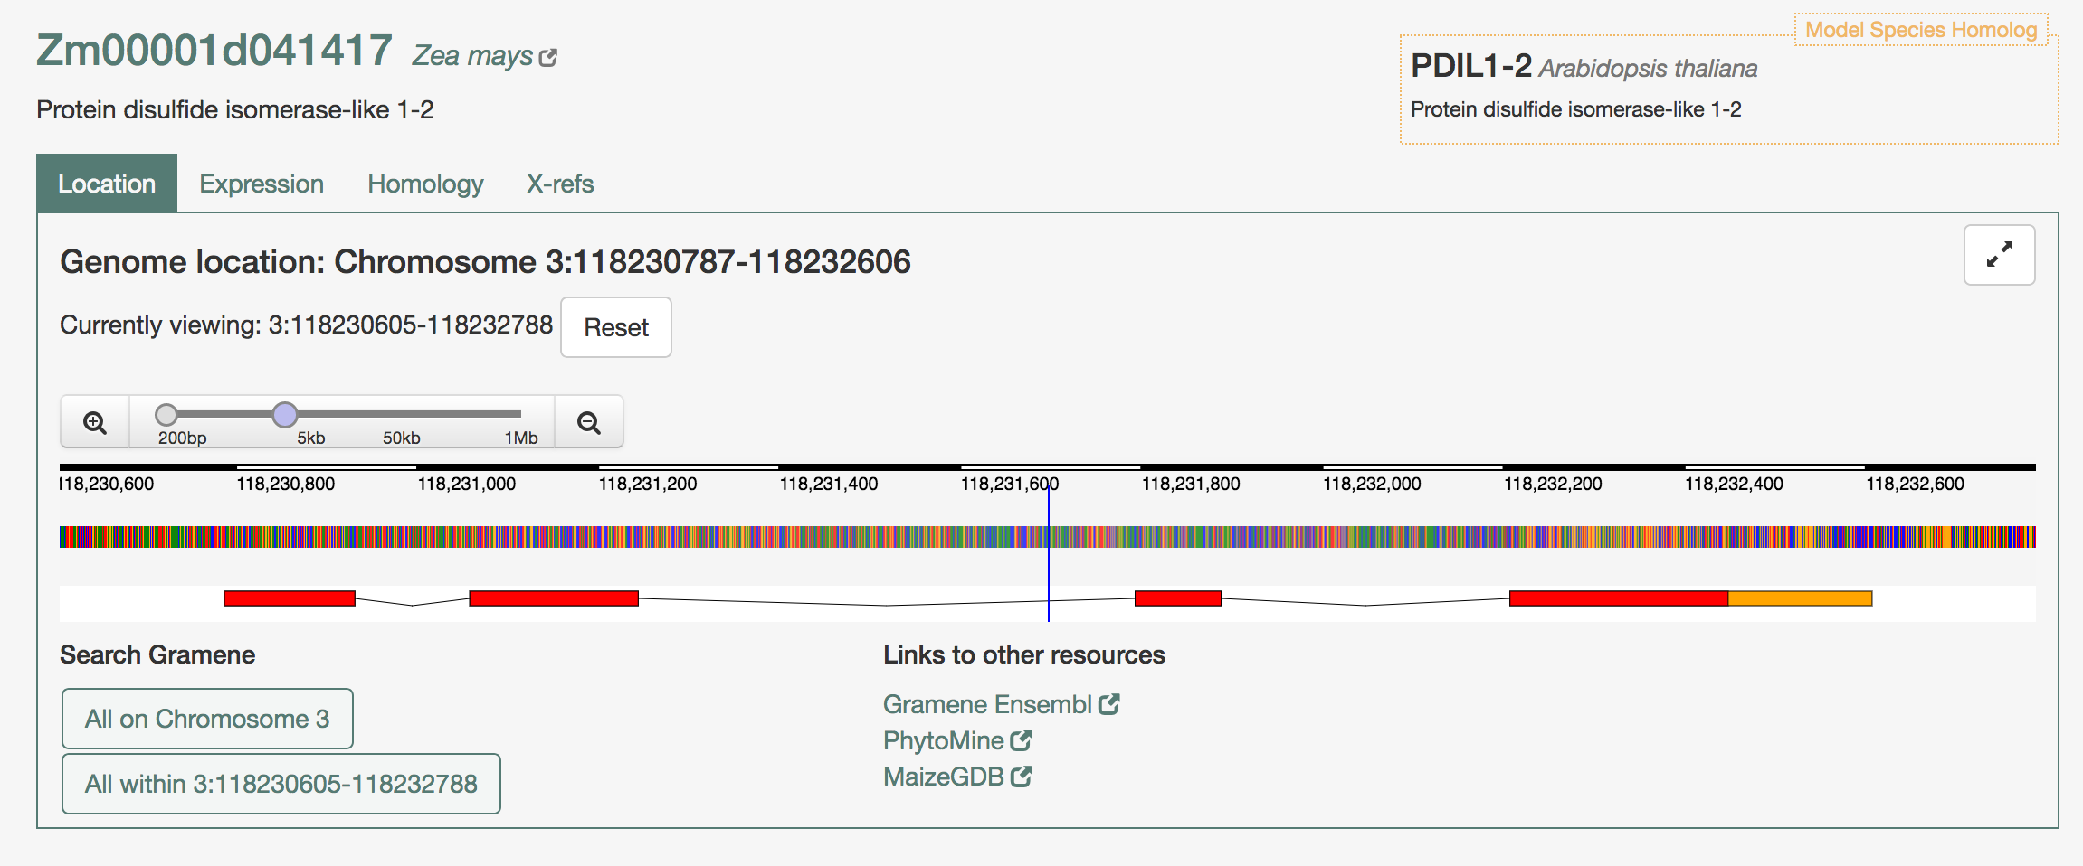
Zm00001d041417
The second gene we are looking into shows four exons and it has been classified as protein disulfide isomerase-like 1-2.

Slide 13
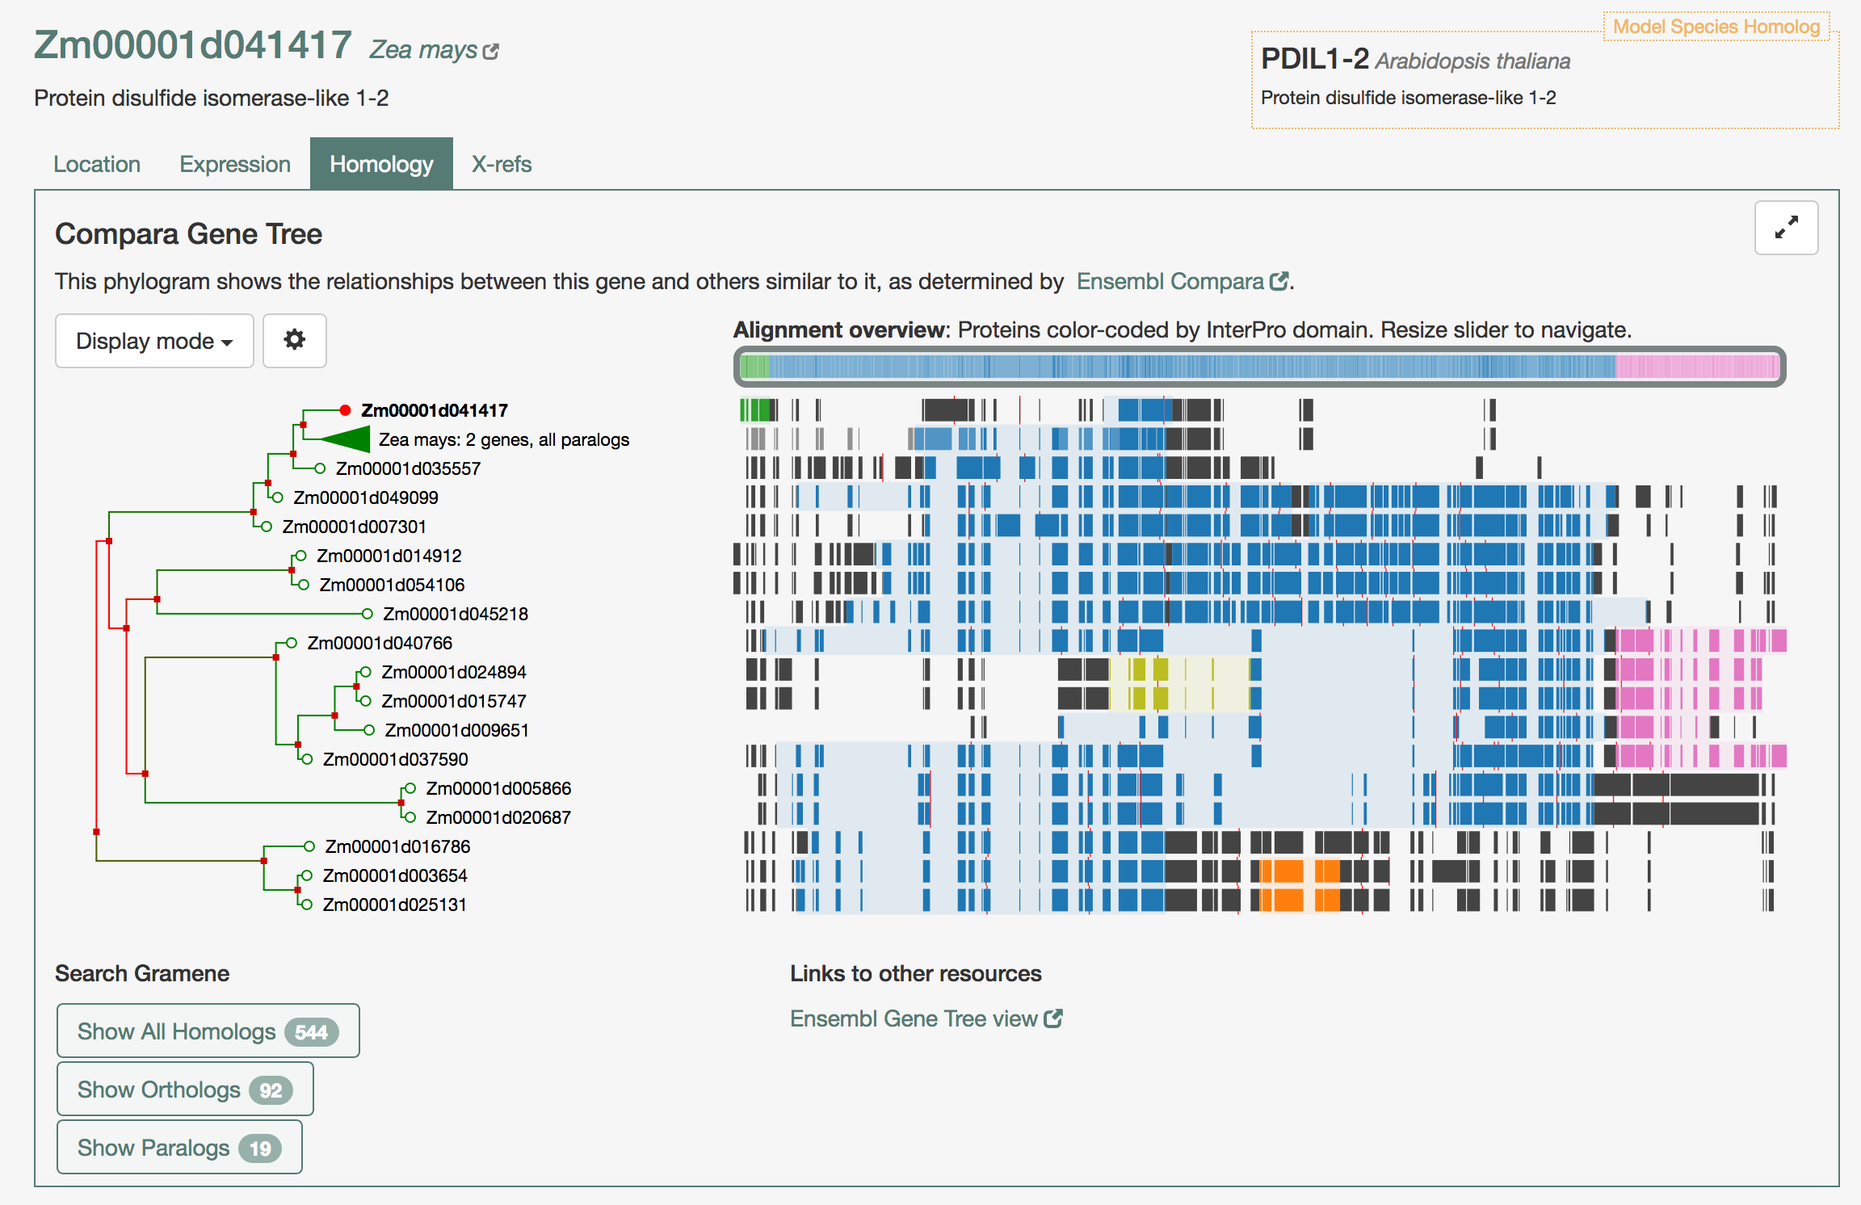
Zm00001d041417
We went back to Gramene to identify the paralogs and it shows they share a common domain for Thioredoxin-like fold. If you check for other domains our gene of interest shows the ZF-HD homeobox protein, Cys/His-rich dimerization domain (green) that correspond to the first exon.

Slide 14
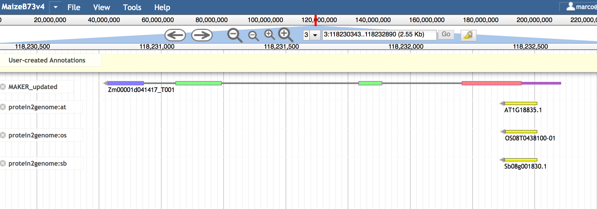
Zm00001d041417
When we locate the gene in Apollo there is no annotation in v3 and v4 shows the protein disulfide isomerase-like
We found some data that match to the ZF-HD homeobox protein from other species but there is no RNA seq data to support the gene model.

Slide 15
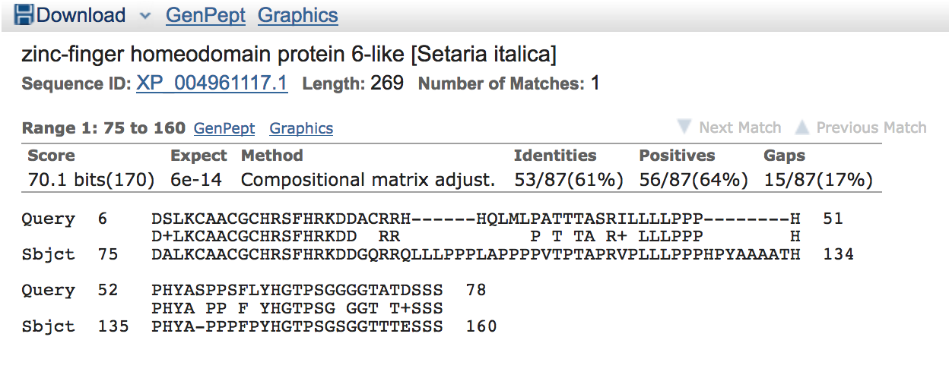
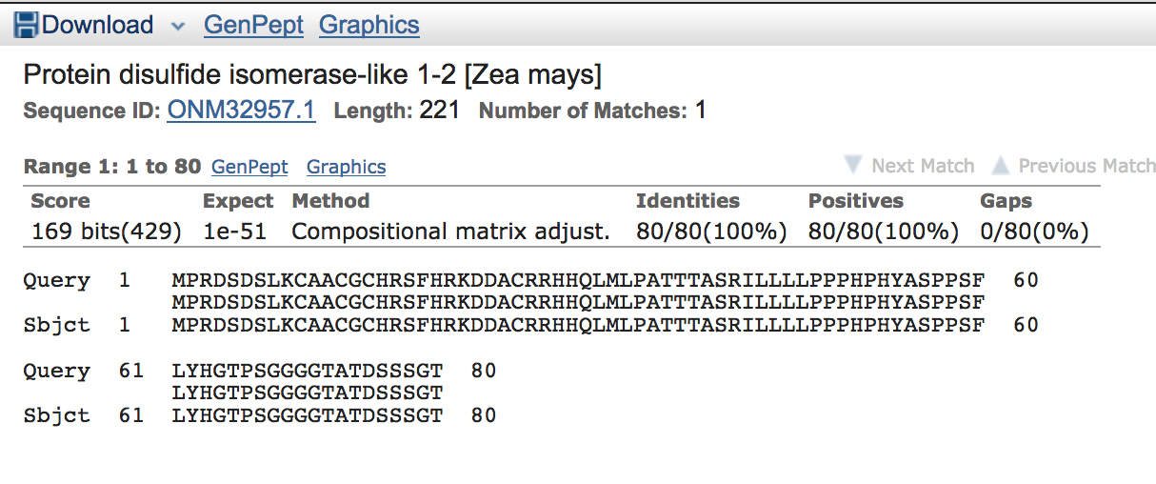
Look for orthologs of Zm00001d041417 using BLAST
When we blast the sequence for the first exon and exclude maize the closest ortholog comes from Setaria and it is a zinc-finger homeodomain protein 6-like and when we don’t exclude maize it will match 100% to the Protein disulfide isomerase 1-2.

Slide 16
Exercise 2: Missing part of a gene in B73v4 assembly
A gene located in Chr9:60754481..60762490 shows a different gene models in both assemblies
It belongs to the S-adenosyl-L-methionine-dependent methyltransferases superfamily protein
V4 missed part of the gene
Apollo detects an issue with a splice junction in one of the exons

Slide 17
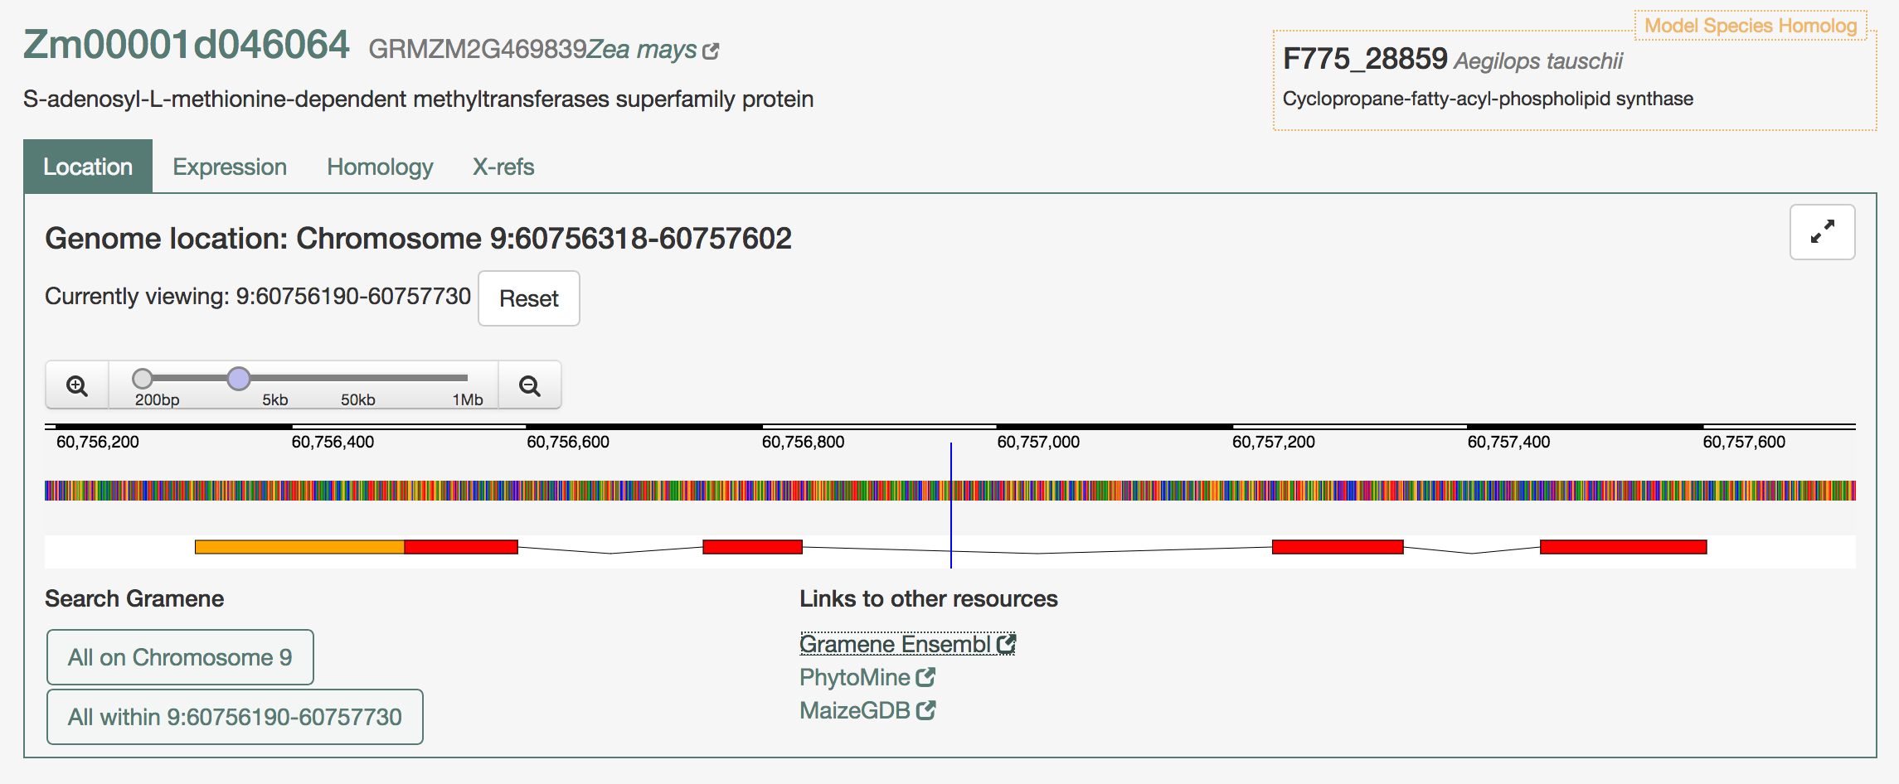
Zm00001d046064
We identify the gene for S-adenosyl-L-methionine-dependent methyltransferase based on the location as well as its structure.

Slide 18
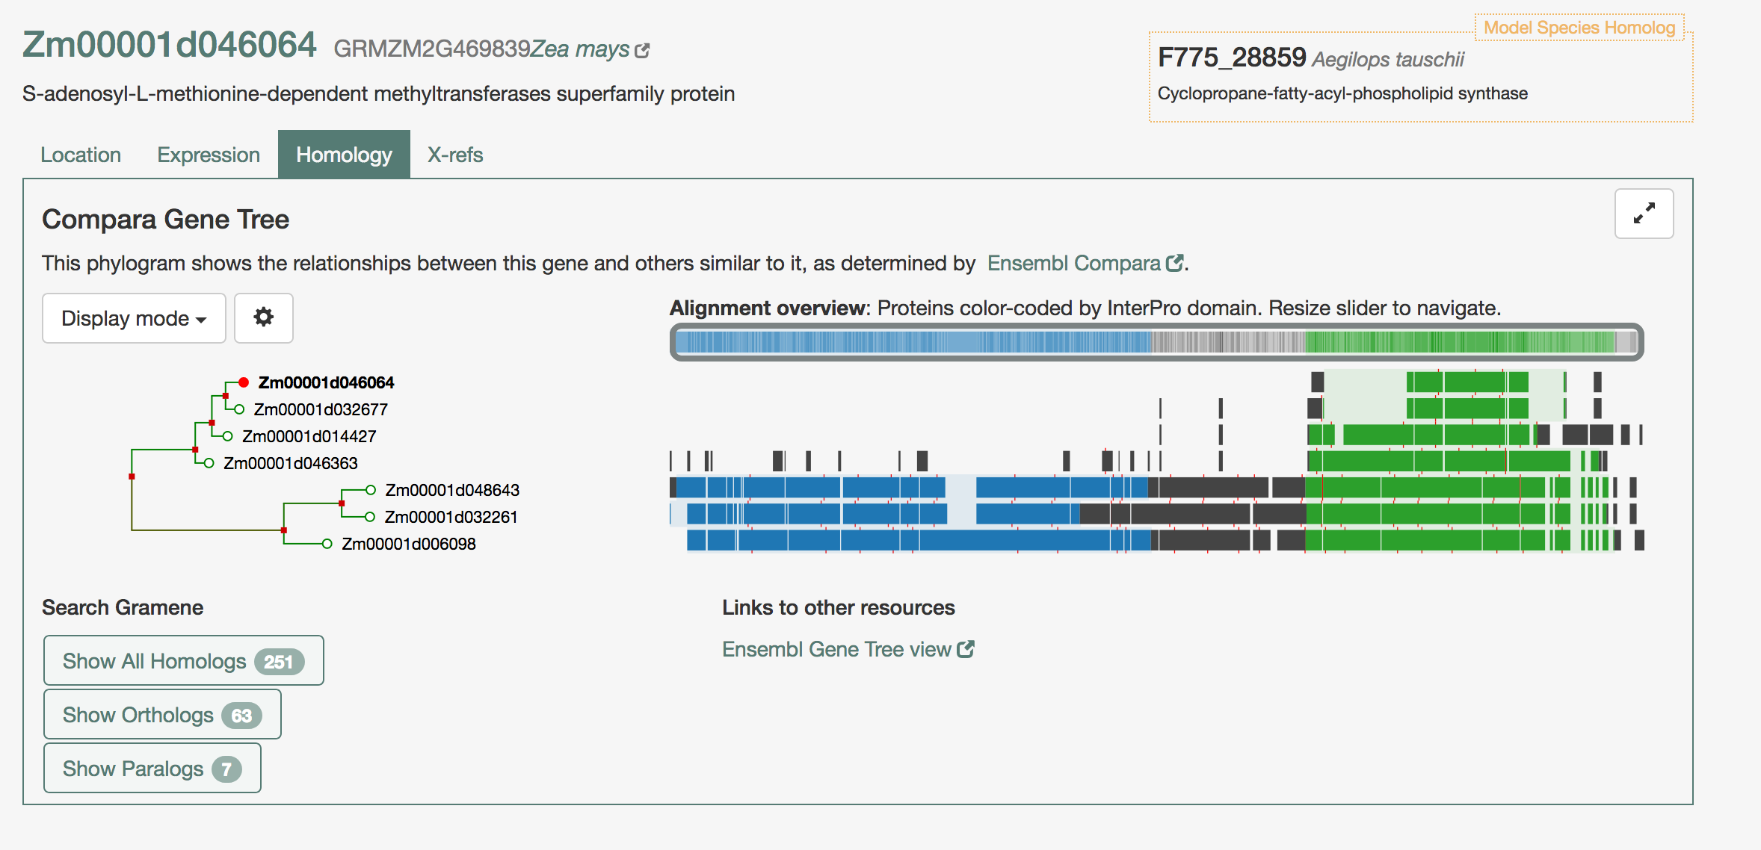
Zm00001d046064
We use Gramene to identify the paralogs and it shows they share a common domain for S-adenosyl-L-methionine-dependent methyltransferase (green) but our gene and other three from the same family lack a second domain: FAD/NAD(P)-binding domain (blue)

Slide 19
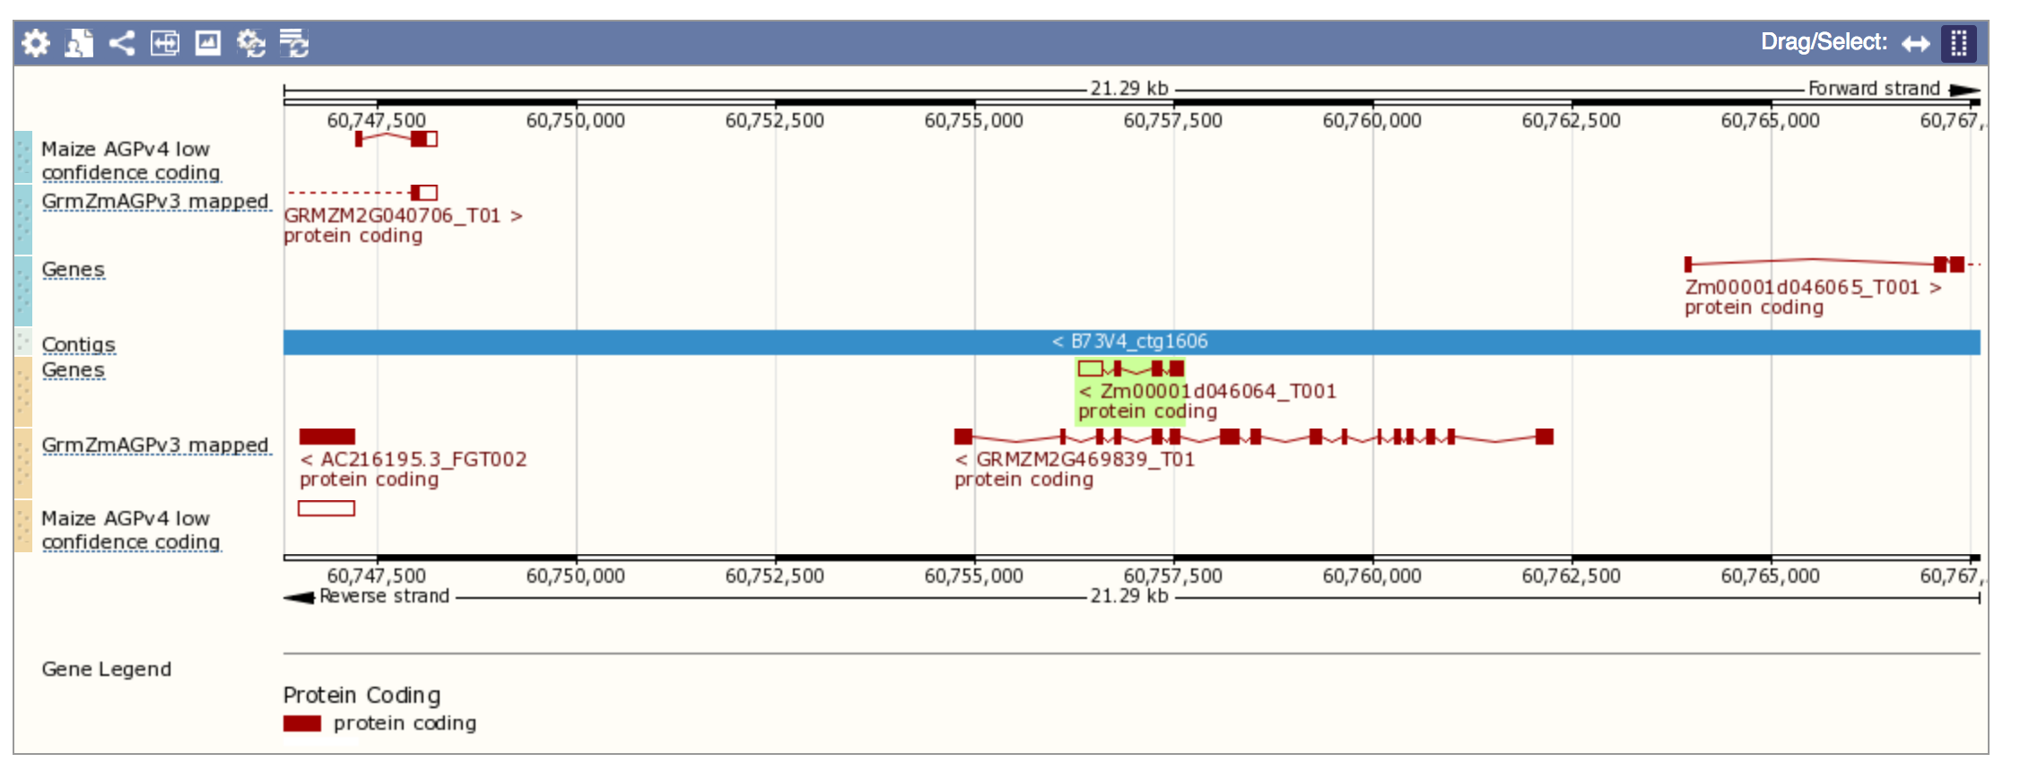
Zm00001d046064
Before going into Apollo we check in Gramene Ensembl to compare with the previous assembly B73v3.
V3 shows a larger gene model that share a few introns with the recent assembly

Slide 20
Looking for the gene in Apollo
Locate the gene in Apollo and activate the tracks for both v3 and v4 assemblies
Move the gene models to the working space and retrieve the protein sequences
Identify the alert for a non canonical splice site in one of the exon number 10.

Slide 21
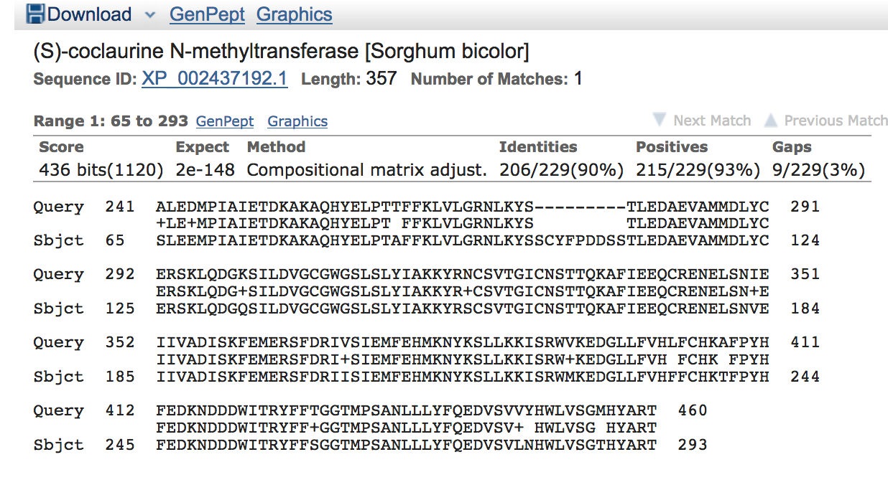
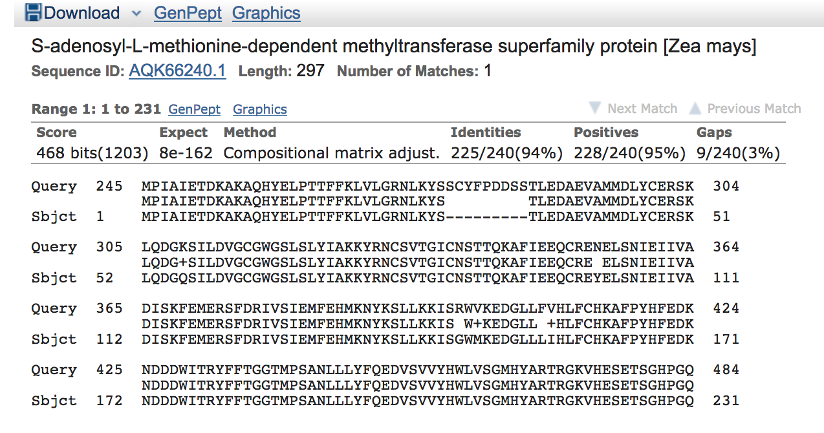
Look for orthologs of this GRMZM2G469839 using BLAST
When we blast the sequence for the long gene GRMZM2G469839 and exclude maize the closest ortholog comes from Sorghum as a S-coclaurine N-methyltransferase and when we include maize the closest match identify the S-adenosyl-L-methionine-dependent methyltransferases superfamily protein from 245 nucleotide position
You can also see a gap due to the non canonical splice site reported for one of the exons.

Slide 22
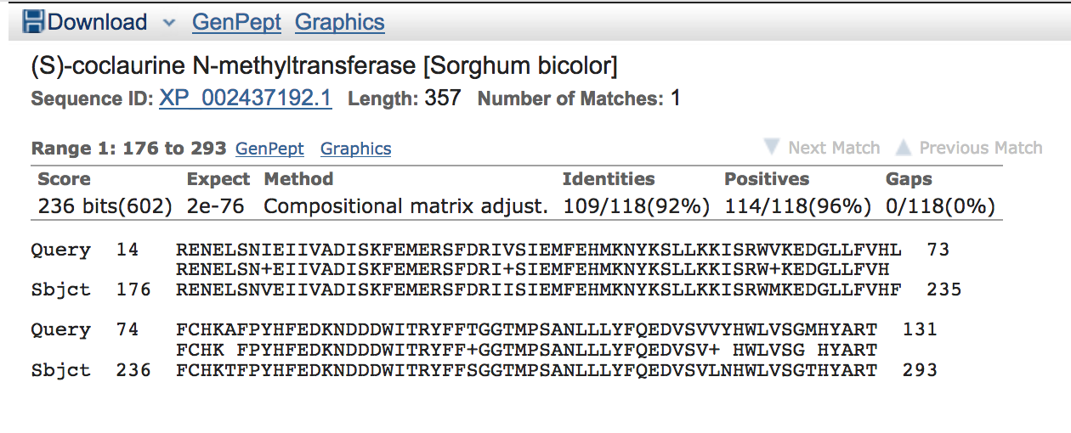
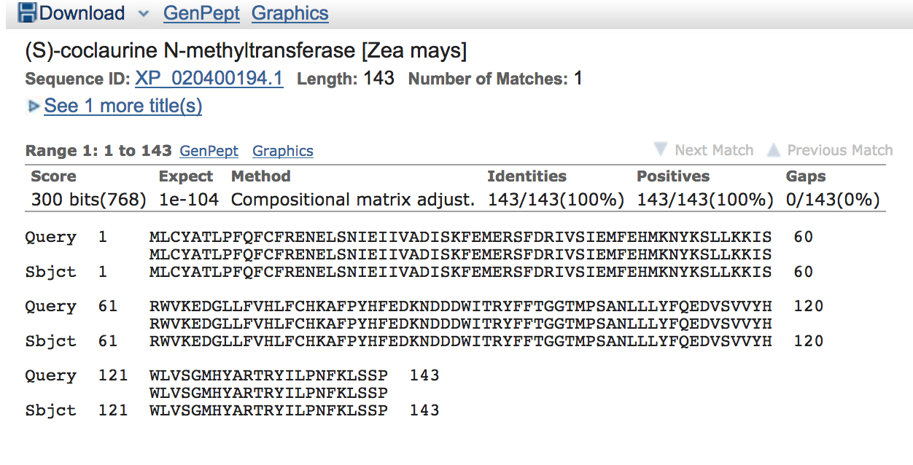
Look for orthologs of this Zm00001d046064 using BLAST
When we blast the sequence for the short gene Zm00001d046064 and exclude maize the closest ortholog comes from Sorghum as a S-coclaurine N-methyltransferase. When we include maize the closest match identify the same family.

Slide 23
Zoom in… Chr9:60754481..60762490
Protein sequence data and RNAseq evidence on pollen suggest smaller exon
The issue resolves when the splice junction is aligned with the RNAseq reads

Slide 24
Zoom in to the nucleotide level…
Note that the gene is in the reverse strand as 3’←5’
Zoom in to detect a canonical splice junction gt .. ag

Slide 25
Looking for evidence data in Apollo
Two models were generated at the same time supported by RNAseq data and sequence data from NCBI

Slide 26
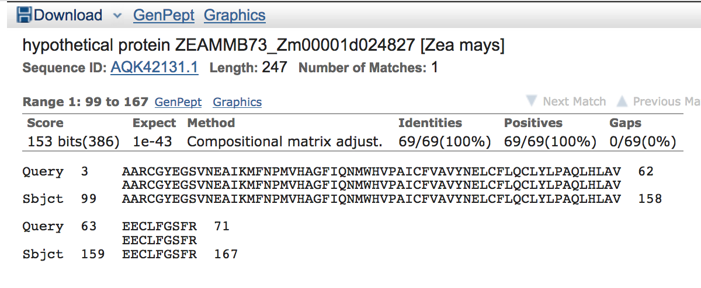
BLAST the extra sequence
When we blast the extra sequence the closest match identify an hypothetical protein.
Only the first exon from that sequence find a match
More data will be needed to correct the model

